Slide 1

RESTAURANT Order Analysis
Pitch

Slide 2

About
Taste of the World Café has diverse menu offerings and serves a generous amount of portions.
At the start of the year they debuted a new menu and they asked me to dig into the customer data to see which menu items are doing well / not well and what the top customers seem to like best .
My objectives are :
1.Explore the menu_items table to get an idea of what’s on the new menu.
2.Explore the order_details table to get an idea of the data that’s been collected.
3.Use both tables to understand how customers are reacting to the new menu.
My job is to use sql to tackle these objectives.
​
About

Slide 3

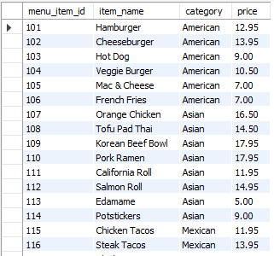
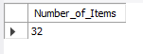
Objective 1
1.View the menu_items table.
SELECT
*
FROM
menu_items;
2.Write a query to find the number of items on the menu.
SELECT
COUNT(*) AS Number_of_Items
FROM
menu_items;

Slide 4
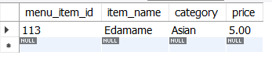
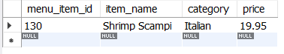
3.What are the least and most expensive items on the menu?
SELECT
*
FROM
menu_items
ORDER BY
price
LIMIT 1;
---------------------------------------------------------------------
SELECT
*
FROM
menu_items
ORDER BY
price DESC
LIMIT 1;

Slide 5
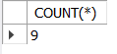
4.How many Italian dishes are on the menu?
SELECT
COUNT(*)
FROM
menu_items
WHERE
category = 'Italian';

Slide 6
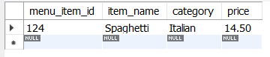
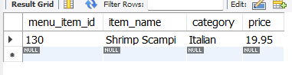
5.What are the least and most expensive Italian dishes on the menu?
SELECT
*
FROM
menu_items
WHERE
category = 'Italian’
ORDER BY
price
LIMIT 1;
-------------------------------------------------------------------------------------
SELECT
*
FROM
menu_items
WHERE
category = 'Italian’
ORDER BY
price DESC
LIMIT 1;

Slide 7
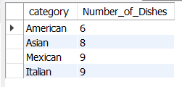
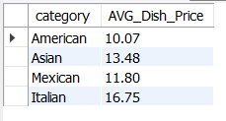
6.How many dishes are in each category?
SELECT
category, COUNT(*) as Number_of_Dishes
FROM
menu_items
GROUP BY
category;
7.What is the average dish price within each category?
SELECT
category, ROUND(AVG(price),2) as AVG_Dish_Price
FROM
menu_items
GROUP BY
category;

Slide 8
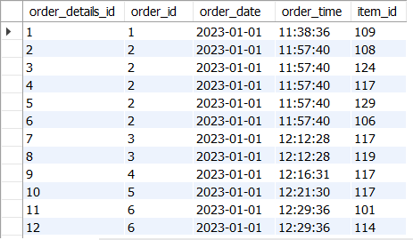
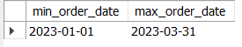
-- Objective_2
1.View the order_details table.
SELECT
*
FROM
order_details;
2.What is the date range of the table?
SELECT
MIN(order_date) AS min_order_date, MAX(order_date) AS max_order_date
FROM
order_details;

Slide 9
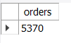
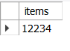
3.How many orders were made within this date range?
SELECT
COUNT(DISTINCT order_id) as orders
FROM
order_details;
4.How many items were ordered within this date range?
SELECT
COUNT(*) as items
FROM
order_details;

Slide 10
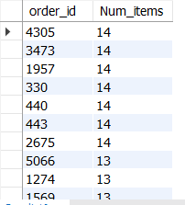
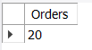
5.Which orders had the most number of items?
SELECT
order_id, COUNT(item_id) AS Num_items
FROM
order_details
GROUP BY
order_id
ORDER BY
2 DESC;
6.How many orders had more than 12 items?
SELECT
COUNT(*) AS Orders
FROM
(SELECT
order_id, COUNT(item_id) AS Num_items
FROM
order_details
GROUP BY
order_id
HAVING
Num_items > 12) AS Num_Orders;

Slide 11
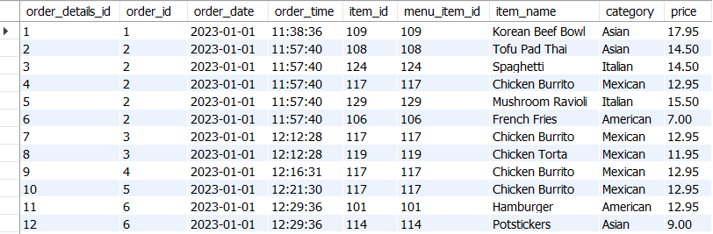
-- Objective_3
1.Combine the menu_items and order_details tables into a single table.
SELECT
*
FROM
order_details o
LEFT JOIN
menu_items m
ON
o.item_id = m.menu_item_id;

Slide 12
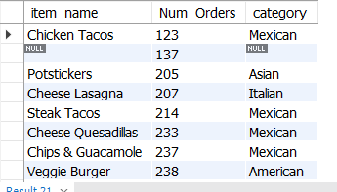
2.What were the least and most ordered items? What categories were they in?
SELECT
item_name,COUNT(order_details_id) AS Num_Orders,category
FROM
order_details o
LEFT JOIN
menu_items m
ON
o.item_id = m.menu_item_id
GROUP BY
item_name,category
ORDER BY 2;

Slide 13
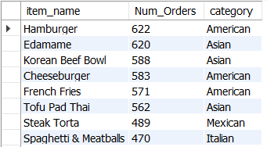
SELECT
item_name,COUNT(order_details_id) AS Num_Orders,category
FROM
order_details o
LEFT JOIN
menu_items m
ON
o.item_id = m.menu_item_id
GROUP BY
item_name,category
ORDER BY
2 DESC;

Slide 14
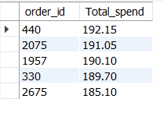
3.What were the top 5 orders that spent the most money?
SELECT
order_id,sum(price) AS Total_spend
FROM
order_details o
LEFT JOIN
menu_items m
ON
o.item_id = m.menu_item_id
GROUP BY
order_id
ORDER BY
2 DESC
LIMIT 5;

Slide 15
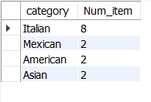
4.View the details of the highest spend order. Which specific items were purchased?
SELECT
category,COUNT(item_id) as Num_item
FROM
order_details o
LEFT JOIN
menu_items m
ON
o.item_id = m.menu_item_id
WHERE
order_id = 440
GROUP BY
category
ORDER BY
2 DESC;

Slide 16
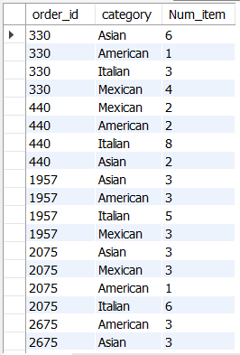
5.View the details of the top 5 highest spend orders.
SELECT
order_id,category,COUNT(item_id) as Num_item
FROM
order_details o
LEFT JOIN
menu_items m
ON
o.item_id = m.menu_item_id
WHERE
order_id in (440,2075,1957,330,2675)
GROUP BY
order_id,category;

Slide 17
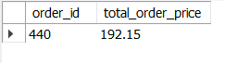
6.How much was the most expensive order in the dataset?
SELECT
o.order_id, SUM(m.price) AS total_order_price
FROM
order_details o
JOIN
menu_items m
ON
o.item_id = m.menu_item_id
GROUP BY
o.order_id
ORDER BY
total_order_price DESC
LIMIT 1;

Slide 18

Thank You For watching
End of sql Case study
Than

